Slide 1

Convolution Networks

Slide 2
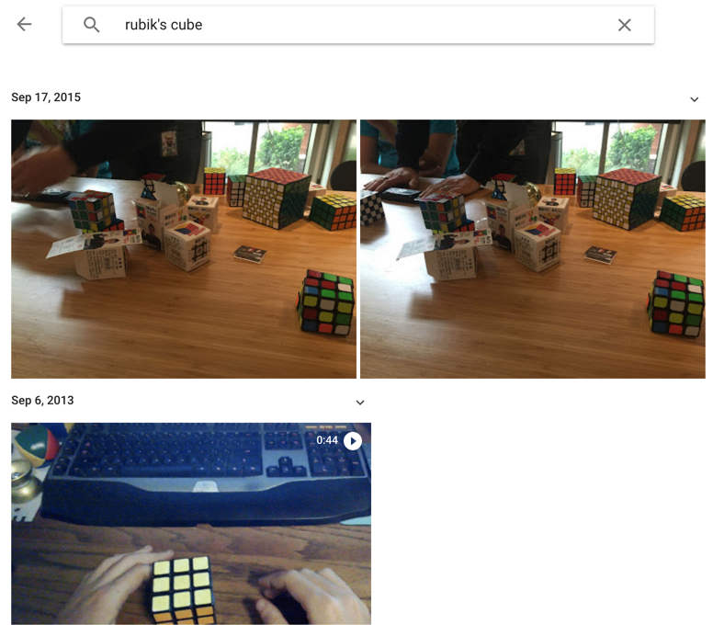
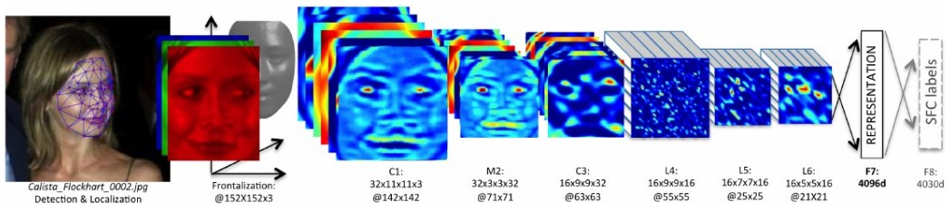
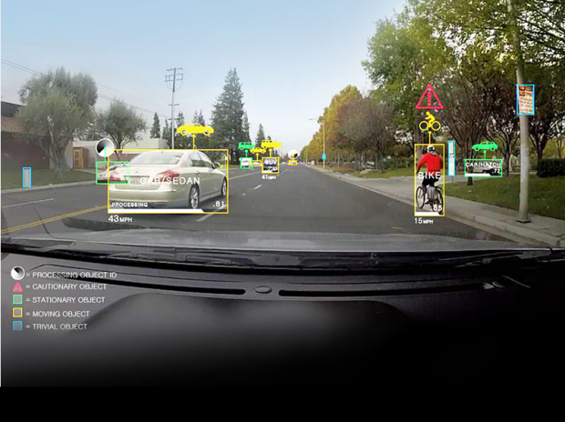
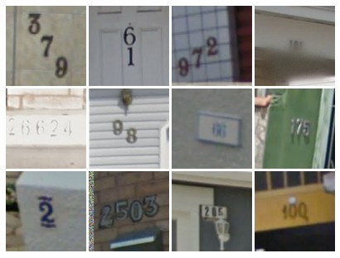
Convolution Networks
Face Verification, Taigman et al. 2014 (FAIR)
e.g. Google Photos search
[Goodfellow et al. 2014]
Self-driving cars

Slide 3
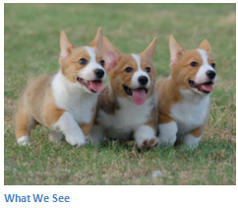
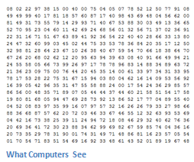
Image Classification
Task of taking an input image and outputting a class
Compute probability of classes that best describes the image
For humans, effortless task

Slide 4
Input Image
An image is an an array of pixel values
A JPG color image with size 480 x 480:
The representative array will be 480 x 480 x 3. Each number is given a value from 0 to 255 which is the pixel intensity
Gray-scale image contains a single sample (intensity value) for each pixel
Image Classification:
Given an array of numbers, compute probabilities of the image belonging to a class

Slide 5
Convolution Networks
A type of deep neural networks with three basic concepts:
Local receptive fields
Shared weights
Pooling

Slide 6
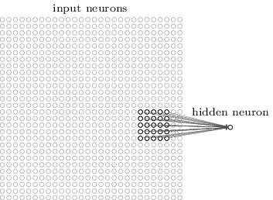
Local Receptive Fields
Connections are from small, localized regions of the input image to hidden layers
A little window on the input pixels
Each neuron in the first hidden layer is connected to a small region of the input neurons. For example, a 5x5 region

Slide 7
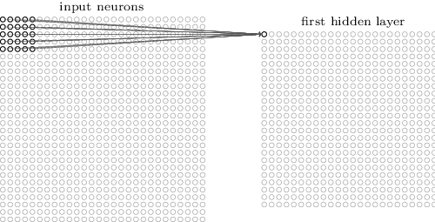
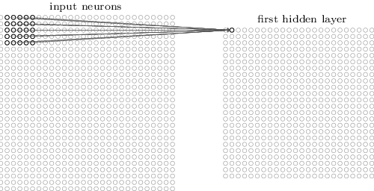
Local Receptive Fields

Slide 8
Convolution
From Goodfellow 2017
Replace matrix multiplication in networks with convolution
The rest (gradient etc.) remains the same
Because of the small kernel, connections are sparse
http://cs231n.github.io/convolutional-networks/

Slide 9
Size, Stride & Padding
A convolution layer takes:
Input volume W₁xH₁xD₁
K number of filters (kernels) of size FxF
A stride or step S
An amount of zero padding P
A convolution layer produces:
Output volume W₂xH₂xD₂
Where:
The d-th W₂xH₂ slice is the conv. of the d-th filter over the input with stride S and d-th bias
W₂=(W₁-F+2P)/S+1
H₂=(H₁-F+2P)/S+1
D₂=K
With weight sharing per filter, it has:
FxFxD₁xK weights
K biases
Common values:
F=3, S=1, P=1
Common Structure:
Input -> [[Conv. -> ReLU]*N -> Pool?]*M -> [FC -> ReLU]*L -> FC
F
S
F
P

Slide 10
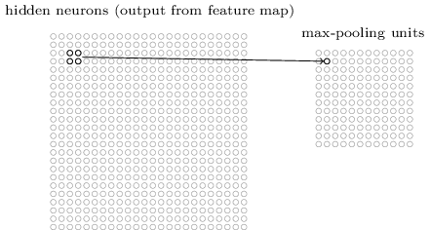

Pooling Layers
Often used immediately after convolutional layers
Simplify the information in the output from the convolutional layer
Take each feature map output from the convolutional layer and prepares a condensed feature map
Max-pooling:
A pooling unit simply outputs the maximum activation in the $p×p$ region

Slide 11
Max Pooling
Single depth slice
1 | 1 | 2 | 4
5 | 6 | 7 | 8
3 | 2 | 1 | 0
1 | 2 | 3 | 4
x
max pool with 2x2 filters and stride 2
6 | 8
3 | 4
y

Slide 12
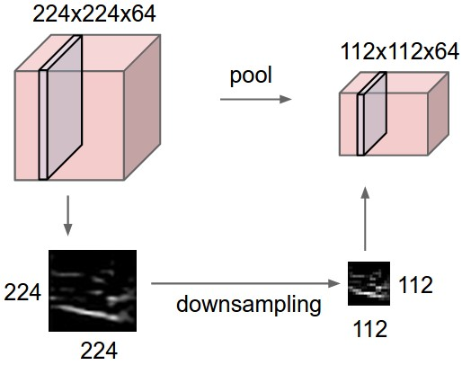
Pooling Layers
Smaller representations and more manageable
Operates over each activation map independently

Slide 13

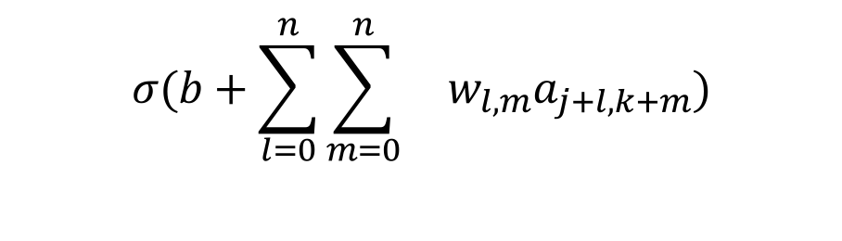
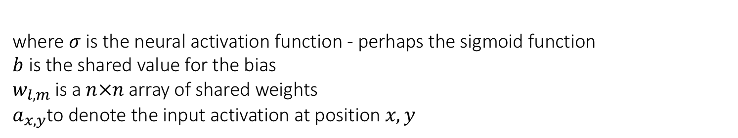
Shared Weights And Biases
Each hidden neuron has a bias and pxp weights connected to its local receptive field
The weights and biases for each of the hidden neurons are the same
In other words, for the ${j, k}^{}$ hidden neuron, the output is:
$$σ(b+\sum_{l=0}^{n}{\sum_{m=0}^{n}{ w_{l,m}a_{j+l,k+m})}}$$
where $σ$is the neural activation function - perhaps the sigmoid function
$b$is the shared value for the bias
$w_{l,m}$is a $n×n$array of shared weights $a_{x,y}$to denote the input activation at position $x, y$

Slide 14

Shared Weights And Biases
Convolutional networks are well adapted to the translation invariance of images
Reduce the number of parameters involved in a convolutional network $(p×p+b)$
Terminology
Feature map/Activation map | Map from the input layer to the hidden layer
Shared weights | Weights defining the feature map
Shared bias | Bias defining the feature map
Kernel/Filter | Shared weights and bias

Slide 15
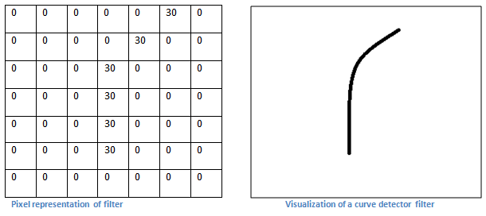
First Layer – High Level Perspective
Filters can be thought of as feature identifiers (straight edges, simple colors, and curves)
In the simple case of a one-filter convolution and a curve detector filter, activation map results in regions that are most likely curves in the picture
More filters mean greater the depth of the activation map
This results in more information about the input

Slide 16
Going Deeper Through The Network
More filters, more features
Many layers are interspersed between convolution layers (example: ReLu and Dropout)
Introduction of nonlinearities
Improve the robustness of the network and control overfitting

Slide 17
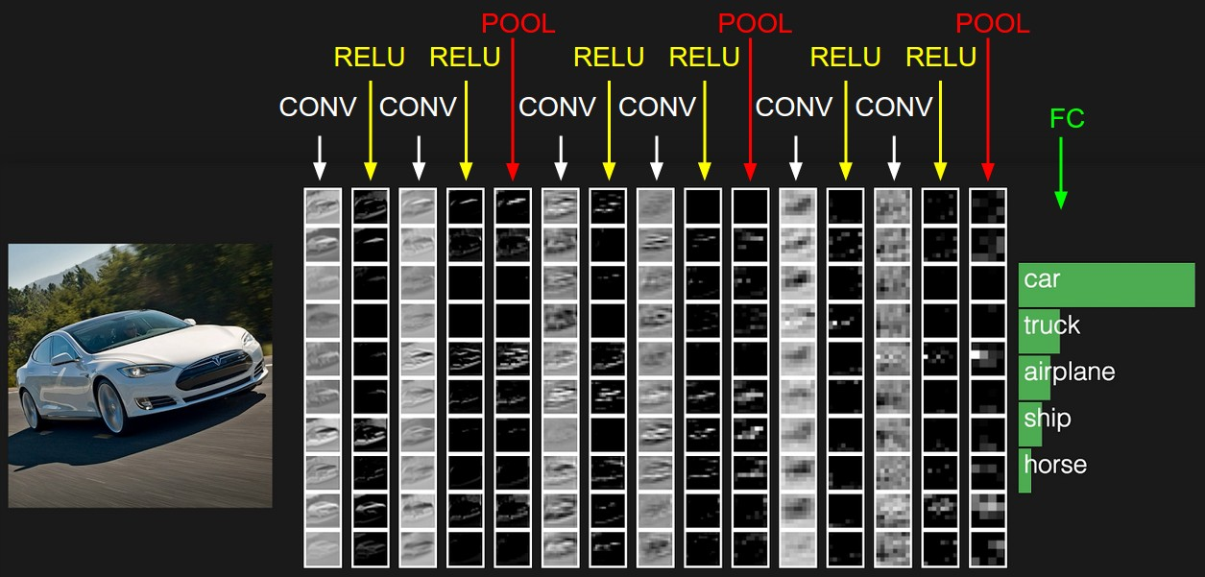
Fully Connected Layer (FC layer)

Slide 18
Q&A

